Slide 1


Cintia M.
26-Jun-2025

Slide 2

Outline
Executive Summary
Introduction
Methodology
Results
Conclusion
Appendix

Slide 3
Executive Summary
Summary of methodologies
Data Collection
Data Wrangling
Exploratory Data Analysis (EDA)
Interactive Visual Analytics
Predictive Analysis (Classification).
Summary of all results:
EDA results
Interactive analytics
Predictive analysis

Slide 4
Introduction
SpaceX advertises Falcon 9 rocket launches on its website with a cost of $62 million. This is considerably cheaper than other providers (which usually cost upwards of $165 million). Much of the savings are because SpaceX can land, and then re-use the first stage of the rocket.
If we can make predictions on whether the first stage will land, we can determine the cost of a launch, and use this information to assess whether or not an alternate company should bid against SpaceX for a rocket launch.
This project will ultimately predict if the Space X Falcon 9 first stage will land successfully.

Slide 5

Section 1

Slide 6
Methodology
1. Data collection
Data was collected using SpaceX API and Web Scraping from Wikipedia.
2. Data Wrangling
One Hot Encoding and Data Cleaning (of null values and irrelevant features) were applied.
3. Exploratory data analysis
EDA was applied using SQL queries and Visualization (Pandas and Matplotlib).
4. Interactive Visual Analytics
Geospatial analytics using Folium and Interactive Dashboard creating with Plotly Dash.
5. Predictive analysis
LR, KNN, SVM, DT models were built and evaluated for the best classifier.

Slide 7
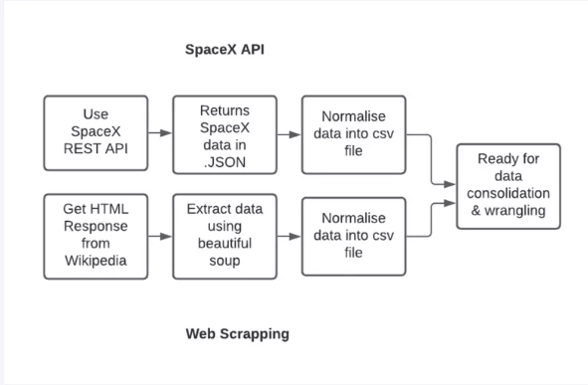
Data Collection
SpaceX REST API was used to retrieve structured launch data, including information about the rocket used, payload delivered, launchpads, landing specifications, and landing outcome.
Web Scraping Wikipedia was also used to extract Falcon 9 & Falcon Heavy launch records (BeautifulSoup was applied to parse HTML tables).

Slide 8
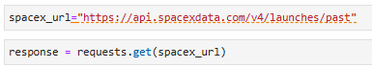
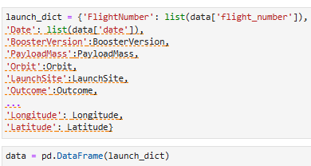
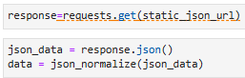
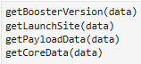

Data Collection - SpaceX REST API calls
Getting Response from API:
Request and decode the response content as a .json file:
Apply custom functions to clean data:
Assign list to dictionary and then to a dataframe (df) :
Filter df to only include `Falcon 9` launches:
GitHub URL with the completed SpaceX API calls: https://github.com/Cintig/AppliedDataScienceCapstoneCourse/blob/2e7e025abf759b131010fce85b949ebc85f46af4/Lab%201%20-%20Collecting%20the%20data%20-%20Completed%20exercise.ipynb

Slide 9
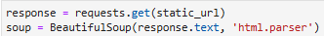
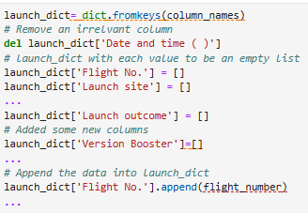
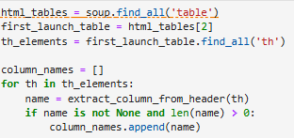

Data Collection – Web Scraping from Wikipedia
Getting Response from HTML and Create a BeautifulSoup object:
Extract column/variable names:
Creation of dictionary by parsing the launch HTML tables:
Converting the dictionary to dataframe:
GitHub URL with the completed Web Scraping calls: https://github.com/Cintig/AppliedDataScienceCapstoneCourse/blob/2e7e025abf759b131010fce85b949ebc85f46af4/Lab%201.2%20-%20Web%20Scraping.ipynb

Slide 10
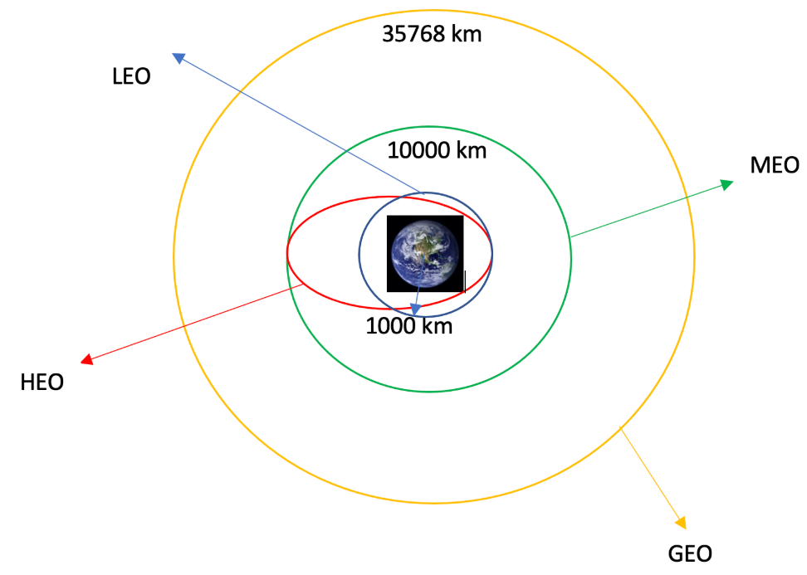
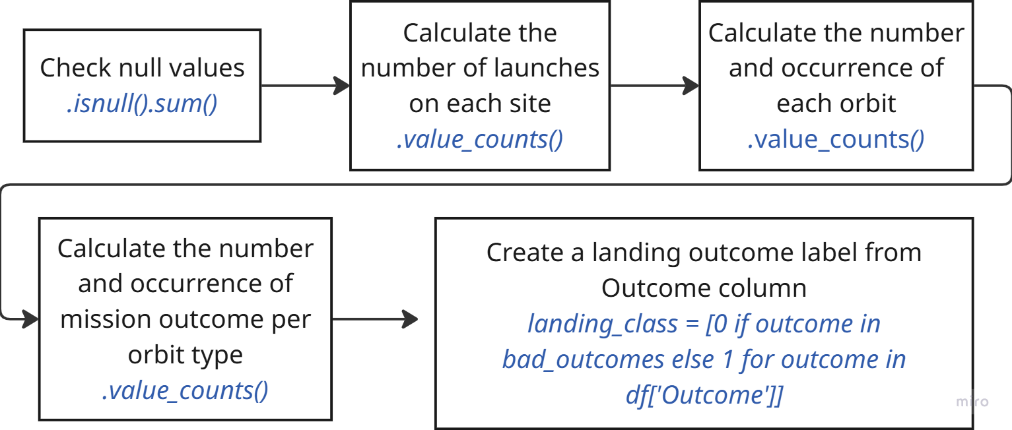
Data Wrangling
GitHub URL: https://github.com/Cintig/AppliedDataScienceCapstoneCourse/blob/2e7e025abf759b131010fce85b949ebc85f46af4/Lab%202%20-%20Data%20Wrangling.ipynb

Slide 11


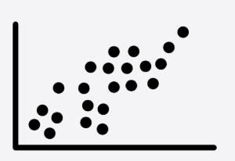
EDA with Data Visualization
SCATTER CHARTS
Scatter charts were produced to visualize the relationships between:
Flight Number and Launch site
Payload and Launch Site
Orbit Type an Flight Number
Payload and Orbit Type
BAR CHARTS
A bar chart was produced to visualize the relationship between:
Success Rate and Orbit Type
LINE CHARTS
Line charts were produced to visualize the relationships between:
Success Rate and Year (launch success yearly trend)
GitHub URL: https://github.com/Cintig/AppliedDataScienceCapstoneCourse/blob/2e7e025abf759b131010fce85b949ebc85f46af4/Lab%204%20-%20EDA%20with%20Visualization%20Lab%20-%20Exploring%20and%20Preparing%20Data.ipynb

Slide 12
EDA with SQL
To gather some information about the dataset, the following SQL queries were performed:
Display the names of the unique launch sites in the space mission
Display 5 records where launch sites begin with the string 'CCA'
Display the total payload mass carried by boosters launched by NASA (CRS)
Display the average payload mass carried by booster version F9 v1.1
List the date when the first successful landing outcome on a ground pad was achieved
List the names of the boosters which had success on a drone ship and a payload mass between 4000 and 6000 kg
List the total number of successful and failed mission outcomes
List the names of the booster versions which have carried the maximum payload mass
List the failed landing outcomes on drone ships, their booster versions, and launch site names for 2015
Rank the count of landing outcomes, such as Failure (drone ship) or Success (ground pad), in descending order
GitHub URL: https://github.com/Cintig/AppliedDataScienceCapstoneCourse/blob/595bf5f093df773fd4d7e9f187564aada401630a/Lab%203%20-%20Complete%20the%20EDA%20with%20SQL.ipynb

Slide 13
Interactive Map built with Folium
The following steps were taken to visualize the launch data on an interactive map:
Mark all launch sites on a map
Initialise the map using a Folium Map object
Add a folium.Circle and folium.Marker for each launch site on the launch map
Mark the success/failed launches for each site on a map
As many launches have the same coordinates, it makes sense to cluster them together.
Before clustering them, assign a marker colour of successful (class = 1) as green, and failed (class = 0) as red.
To put the launches into clusters, for each launch, add a folium.Marker to the MarkerCluster() object.
Create an icon as a text label, assigning the icon_color as the marker_colour determined previously.
Calculate the distances between a launch site to its proximities
To explore the proximities of launch sites, calculations of distances between points can be made using the Lat and Long values.
After marking a point using the Lat and Long values, create a folium.Marker object to show the distance.
To display the distance line between two points, draw a folium.Polyline and add this to the map.
GitHub URL: https://github.com/Cintig/AppliedDataScienceCapstoneCourse/blob/2e7e025abf759b131010fce85b949ebc85f46af4/Lab%205%20-%20Interactive%20Visual%20Analytics%20with%20Folium%20lab.ipynb

Slide 14
Dashboard built with Plotly Dash
The following plots were added to a Plotly Dash dashboard to have an interactive visualization of the data:
Pie chart (px.pie()) showing the total successful launches per site.
This makes it clear to see which sites are most successful.
The chart could also be filtered (using a dcc.Dropdown() object) to see the success/failure ratio for an individual site.
2. Scatter graph (px.scatter()) to show the correlation between outcome (success or not) and payload mass (kg)
This could be filtered (using a RangeSlider() object) by ranges of payload masses
It could also be filtered by booster version
GitHub URL: https://github.com/Cintig/AppliedDataScienceCapstoneCourse/blob/2e7e025abf759b131010fce85b949ebc85f46af4/Lab%206%20-%20Build%20an%20Interactive%20Dashboard%20with%20Plotly%20Dash/spacex-dash-app.py

Slide 15
Predictive Analysis (Classification)
The following steps were taken to develop, evaluate, and find the best performing classification model:
Model Development
To prepare the dataset for model development:
Load dataset
Perform necessary data transformations (standardise and pre-process)
Split data into training and test data sets, using train_test_split()
Decide which type of machine learning algorithms are most appropriate
For each chosen algorithm:
Create a GridSearchCV object and a dictionary of parameters
Fit the object to the parameters
Use the training data set to train the model
Model Evaluation
For each chosen algorithm:
Using the output GridSearchCV object:
Check the tuned hyperparameters (best_params_)
Check the accuracy (score and best_score_)
Plot and examine the Confusion Matrix
Finding the Best
Classification Model
Review the accuracy scores for all chosen algorithms
The model with the highest accuracy score is determined as the best performing model
GitHub URL: https://github.com/Cintig/AppliedDataScienceCapstoneCourse/blob/7b2c3cfb848d0925196e2a0f1ec22b1599d15ad5/Lab%207%20-%20Complete%20the%20Machine%20Learning%20Prediction%20lab.ipynb

Slide 16
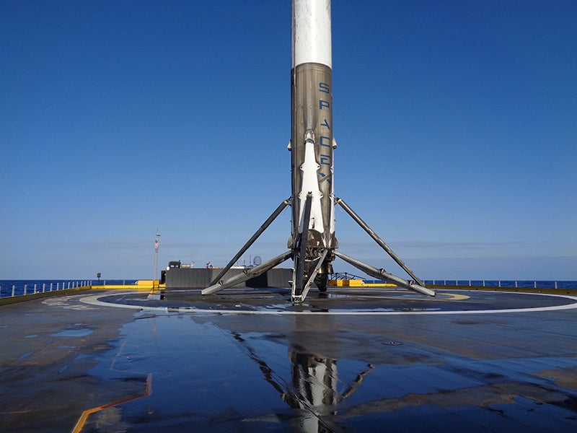
Results
Exploratory Data Analysis (EDA)
Interactive Analytics
Predictive Analysis

Slide 17

Section 2

Slide 18
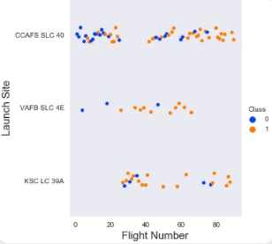
Flight Number vs. Launch Site
The scatter plot of Launch vs Flight Number shows the following:
As the number of flights increases, the success rate seems to increase for each launch site.
Mos of the early flights (Flight Number < 30) were launched from CCAFS SLC 40, and were generally unsuccessful.
Launches from VAFB SLC 4E followed a similar pattern.
No early flights were launched from KSC LC 39A, so the launches from this site are more successful.
From flight number ~30 and onward, successful landings (Class = 1) become more frequent.

Slide 19
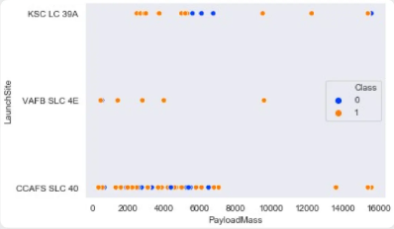
Payload vs. Launch Site
The scatter plot of Payload Mass vs. Launch Site shows the following:
Above a payload mass of around 7000 kg, there are very few unsuccessful landings, but there is also far less data for these heavier launches.
There is no clear correlation between payload mass and success rate for a given launch site.
All sites launched a variety of payload masses, with most of the launches from CCAFS SLC 40 being comparatively lighter payloads (with some outliers).

Slide 20
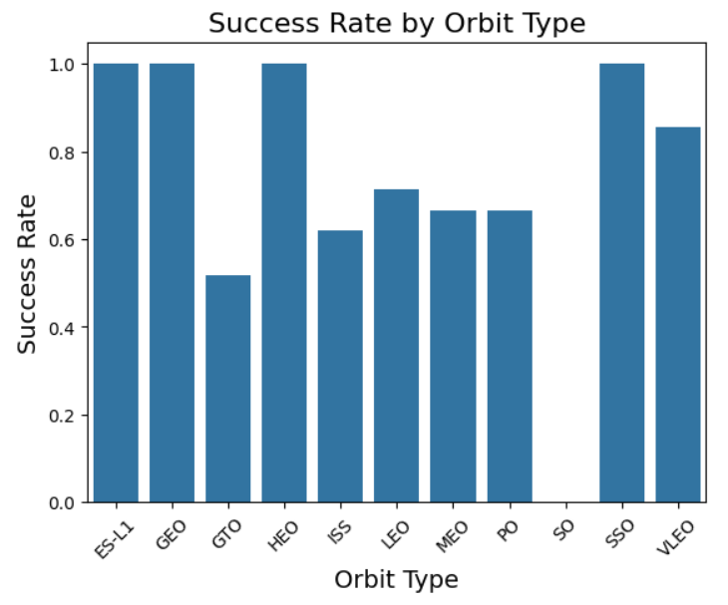
Success Rate vs. Orbit Type
The bar chart of Success Rate vs. Orbit Type shows that the following orbits have the highest (100%) success rate:
ES-L1 (Earth-Sun First Lagrangian Point)
GEO (Geostationary Orbit)
HEO (High Earth Orbit)
SSO (Sun-synchronous Orbit)
The orbit with the lowest (0%) success rate is:
SO (Heliocentric Orbit)

Slide 21
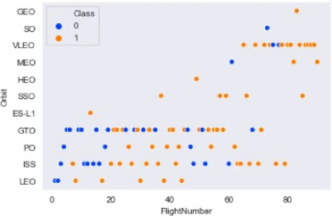
Flight Number vs. Orbit Type
This scatter plot of Orbit Type vs. Flight number shows a few useful things that the previous plots did not, such as:
The 100% success rate of GEO, HEO, and ES-L1 orbits can be explained by only having 1 flight into the respective orbits.
The 100% success rate in SSO is more impressive, with 5 successful flights.
There is little relationship between Flight Number and Success Rate for GTO.
Generally, as Flight Number increases, the success rate increases. This is most extreme for LEO, where unsuccessful landings only occurred for the low flight numbers (early launches).

Slide 22
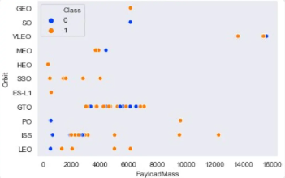
Payload vs. Orbit Type
This scatter plot of Payload Mass vs. Orbit Type shows the following:
The following orbit types have more success with heavy payloads:
ISS
LEO
PO (although the number of data points is small)
For GTO, the relationship between payload mass and success rate is unclear.
VLEO (Very Low Earth Orbit) launches are associated with heavier payloads.

Slide 23
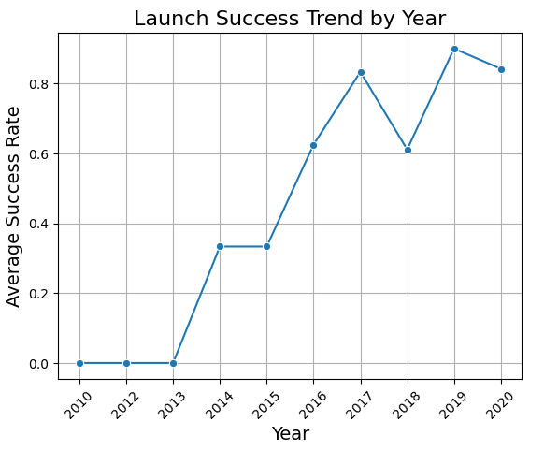
Launch Success Yearly Trend
The line chart of yearly average success rate shows that:
Between 2010 and 2013, all landings were unsuccessful (as the success rate is 0).
After 2013, the success rate generally increased, despite small dips in 2018 and 2020.

Slide 24
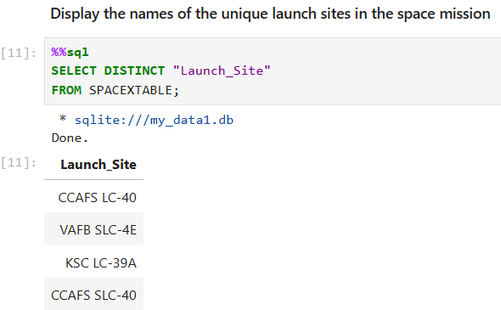
All Launch Site Names
The keyword DISTINCT was used to find the names of the unique launch sites.

Slide 25
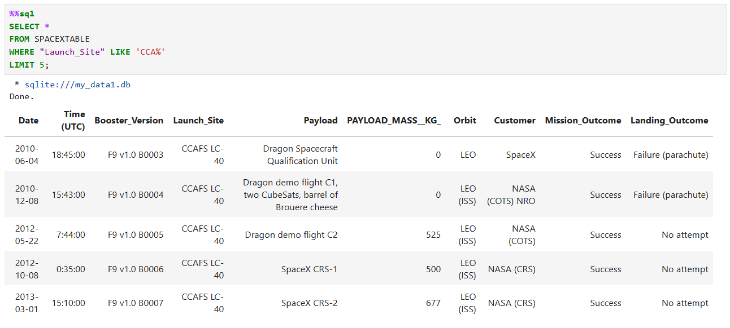
Launch Site Names Begin with 'CCA'
The query below was used to display 5 records where launch sites begin with ‘CCA’:

Slide 26
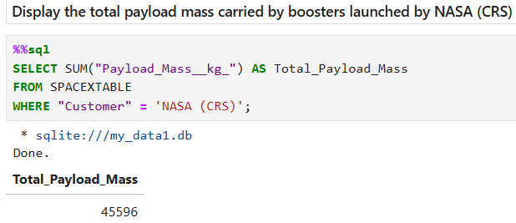
Total Payload Mass
The total payload carried by boosters from NASA was calculated.

Slide 27
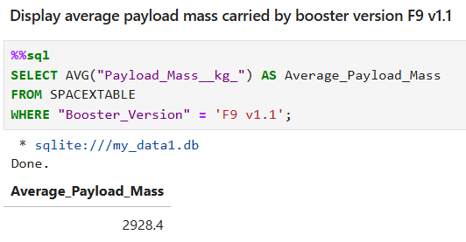
Average Payload Mass by F9 v1.1
The average payload mass carried by booster version F9 v1.1 was calculated.

Slide 28
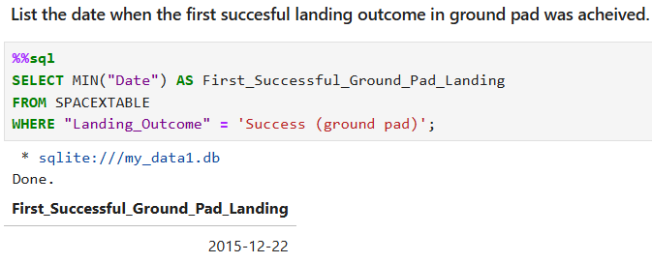
First Successful Ground Landing Date
The date of the first successful landing outcome on ground pad was 22-Dec-2015

Slide 29
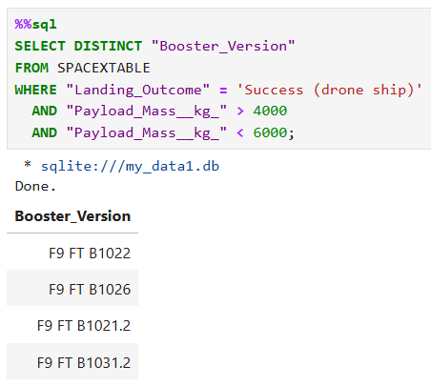
Successful Drone Ship Landing with Payload
between 4000 and 6000
The WHERE clause was used to filter for boosters which have successfully landed on drone ship. Additionally, the AND condition was applied to determine successful landing with payload mass greater than 4000 but less than 6000

Slide 30
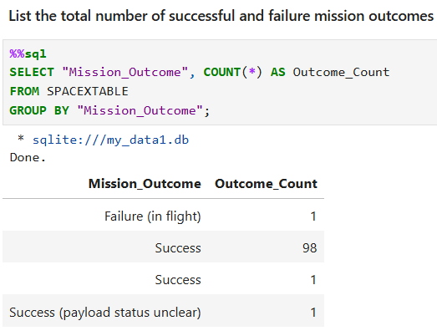
Total Number of Successful and Failure Mission Outcomes
The COUNT keyword was used to calculate the total number of mission outcomes, and the GROUPBY keyword was also used to group these results by the type of mission outcome.

Slide 31
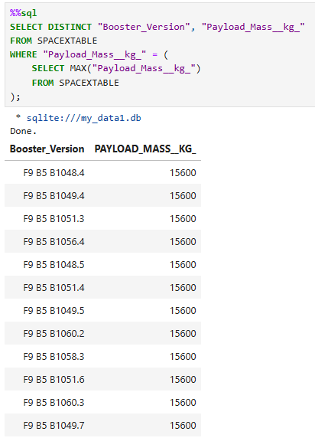
Boosters Carried Maximum Payload
A subquery in the WHERE clause and the MAX() function were used to determine the booster versions which have carried the maximum payload.

Slide 32
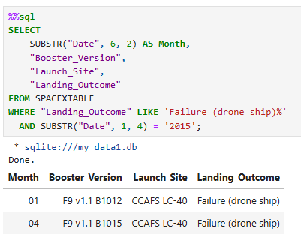
2015 Launch Records
A combination of the WHERE clause, LIKE, and AND conditions were used to get the failed landing outcomes in drone ship, their booster versions, and the launch sites names in year 2015.

Slide 33
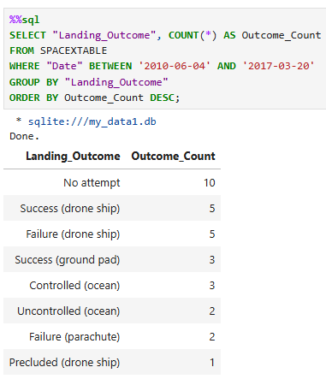
Rank Landing Outcomes Between
2010-06-04 and 2017-03-20
A combination of the COUNT function, WHERE clause, BETWEEN, and AND conditions were used to get the Landing outcomes between the 4-Jun-2010 and 20-Mar-2017.
Additionally, the GROUP BY and ORDER BY clauses were used to group de landing outcomes and ordered them in descending order.

Slide 34

Section 3

Slide 35
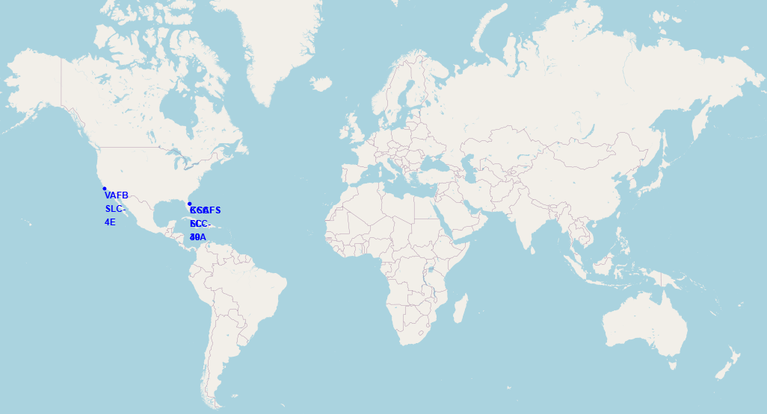
All launch sites global map markers
All SpaceX launch sites are on coasts on the United States of America, specifically Florida and California.

Slide 36
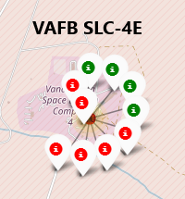
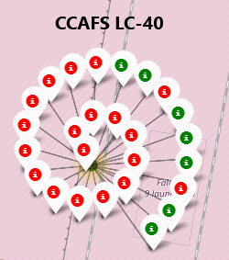
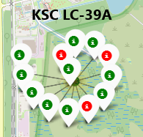
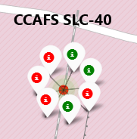
Markers showing launch sites with color labels
California Launch Site
Florida Launch Sites
Green Markers show successful launches and Red Markers show failures.

Slide 37
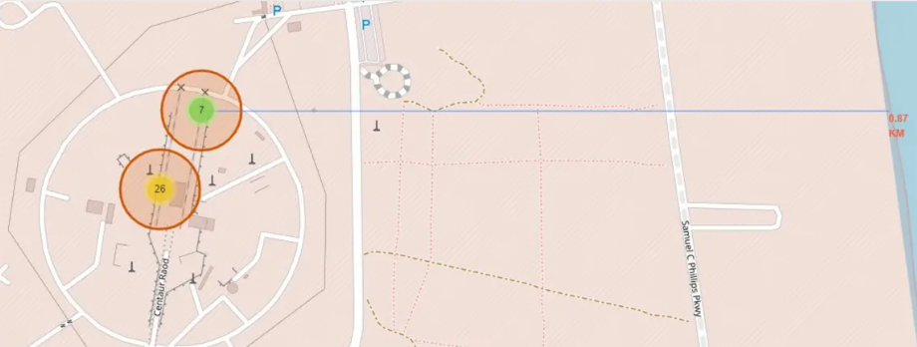
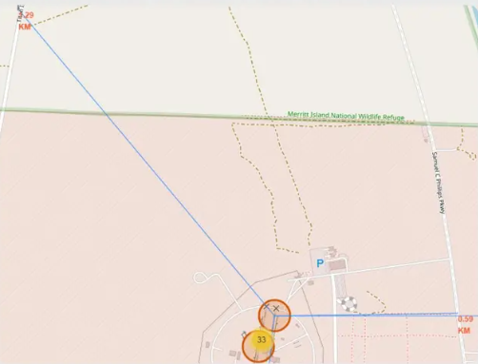
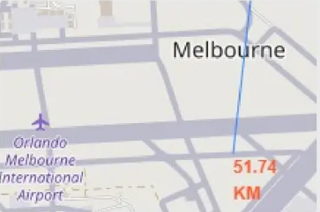
Proximity of Launch sites to other points of interest
Using the CCAFS SLC-40 launch site as an example, we can understand more about the placement of launch sites.
Q1: Are launch sites in close proximity to coastline?
YES. The coastline is only 0.87 km due East.
Q2: Are launch sites in close proximity to highways?
YES. The nearest highway is only 0.59 km away.
Q3: Are launch sites in close proximity to railways?
YES. The nearest railway is only 1.29 km away.
Q4: Do launch sites keep certain distance away from cities?
YES. The nearest city is 51.74 km away.

Slide 38

Section 4

Slide 39
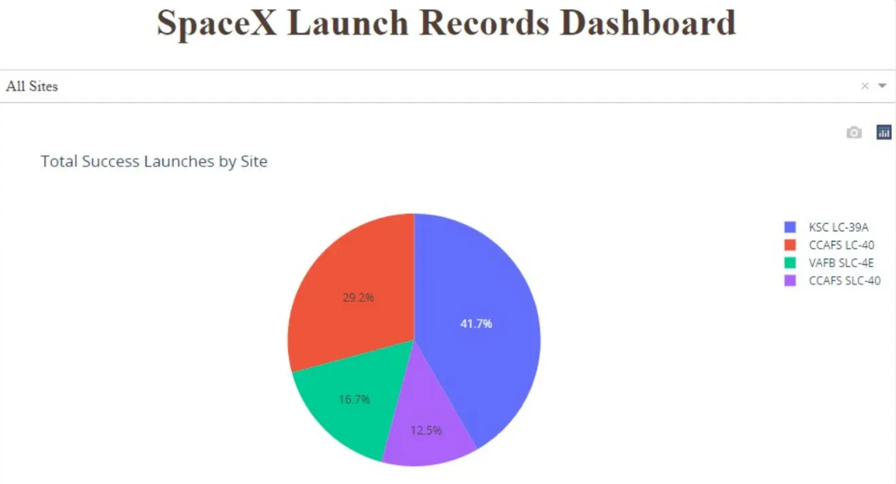
Pie chart showing the success percentage achieve by each launch site
We can observe that KSC LC-39A had the most successful launches from all the sites.

Slide 40
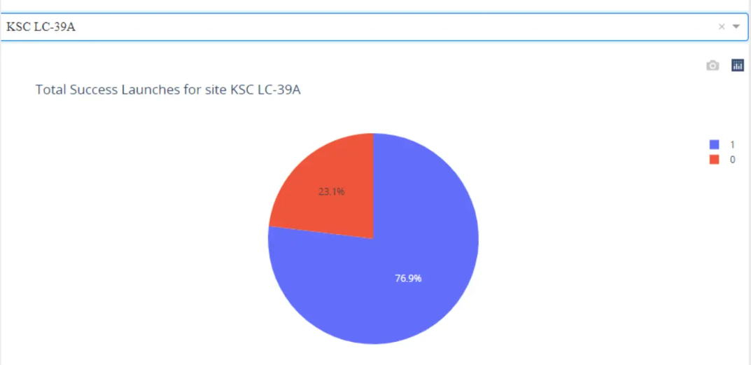
Launch site with highest launch success ratio
The launch site KSC LC-39A also had the highest rate of successful launches, with a 76,9% success rate.

Slide 41
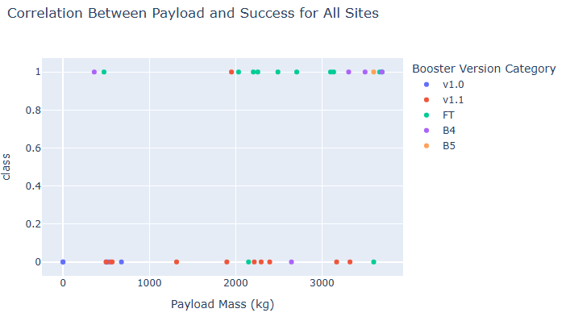


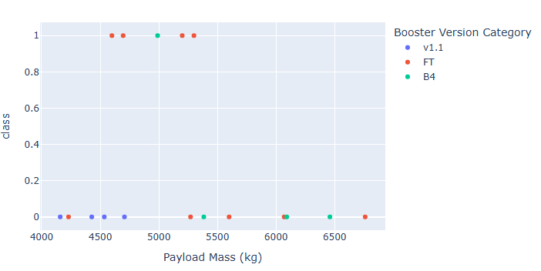
Payload vs. Launch Outcome scatter plot for all sites
Plotting the launch outcome vs. payload for all sites shows a gap around 4000 kg, so it makes sense to split the data into 2 ranges:
0 - 4000 kg (low payloads)
4000 - 10000 kg (massive payloads)
From these 2 plots, it can be shown that the success for massive payloads is lower than that for low payloads.
It is also worth noting that some booster types (v1.0 and B5) have not been launched with massive payloads.

Slide 42

Section 5

Slide 43
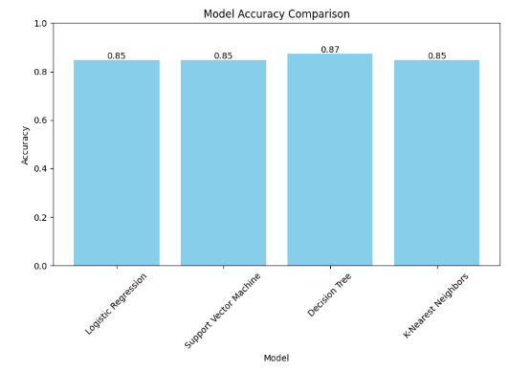
Classification Accuracy
The Decision Tree classifier is the model with the highest classification accuracy with a score of 87,32%

Slide 44
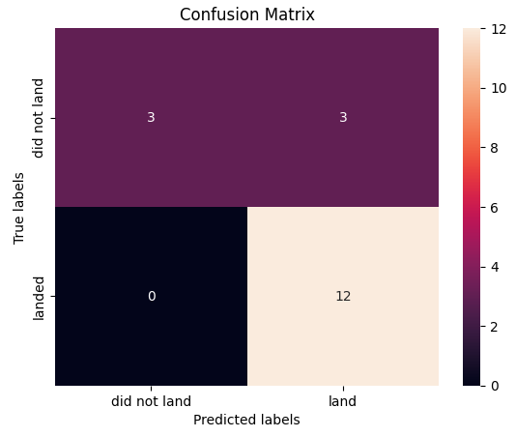
Confusion Matrix
The confusion matrix (for all models) shows that the classifier can distinguish between the different classes.
The major problem is the false positives (unsuccessful landing marked as successful by the classifier)

Slide 45
Conclusions
Success Rate and Number of Flights: As the number of flights increases, the rate of success at a launch site increases, with most early flights being unsuccessful.
Orbit Types and Success Rates: Orbit types ES-L1, GEO, HEO, and SSO, have the highest (100%) success rate.
The 100% success rate of GEO, HEO, and ES-L1 orbits can be explained by only having 1 flight into the respective orbits.
The 100% success rate in SSO is more impressive, with 5 successful flights.
The orbit types PO, ISS, and LEO, have more success with heavy payloads while VLEO (Very Low Earth Orbit) launches are associated with heavier payloads.
Launch Site Success: The launch site KSC LC-39A had the most successful launches, with 41.7% of the total successful launches, and also the highest rate of successful launches, with a 76.9% success rate.
Predictive Analysis: The Decision Tree classifier is the model with the highest classification accuracy with a score of 87,32%.

Slide 46
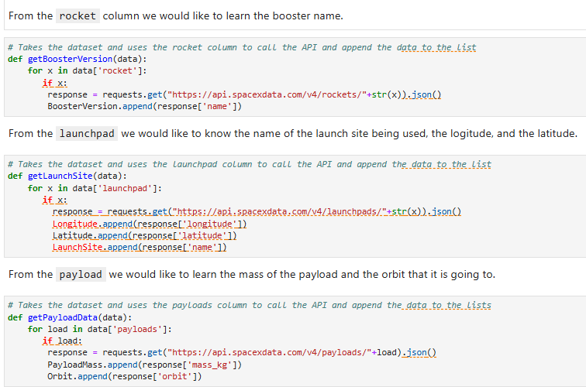
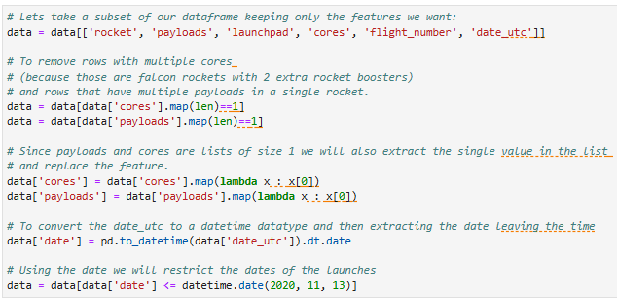
Appendix 1 – Data Collection SpaceX Rest API
Customs functions followed to retrieve the required information and clean the data:

Slide 47
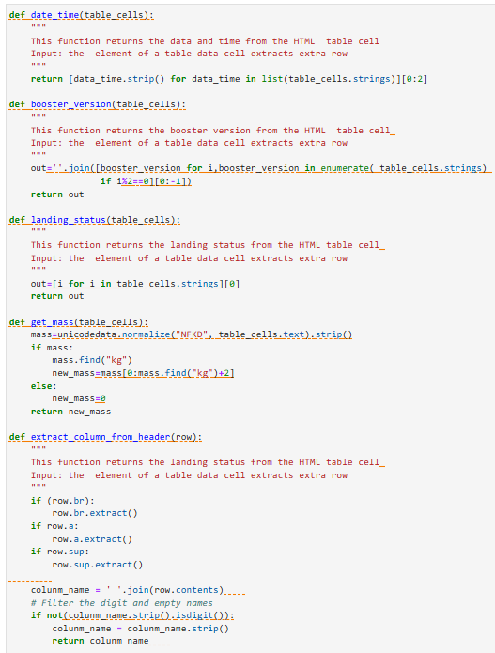
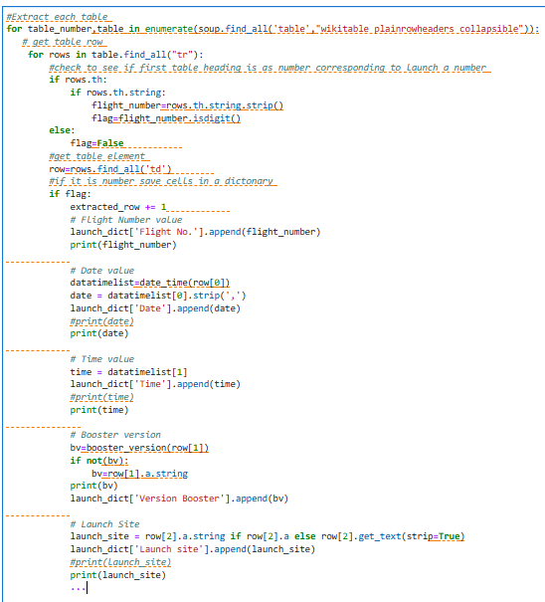
Appendix 2 – Data Collection Web Scraping
Customs functions and custom logic followed to fill up the launch_dict with values from the launch tables.

Slide 48
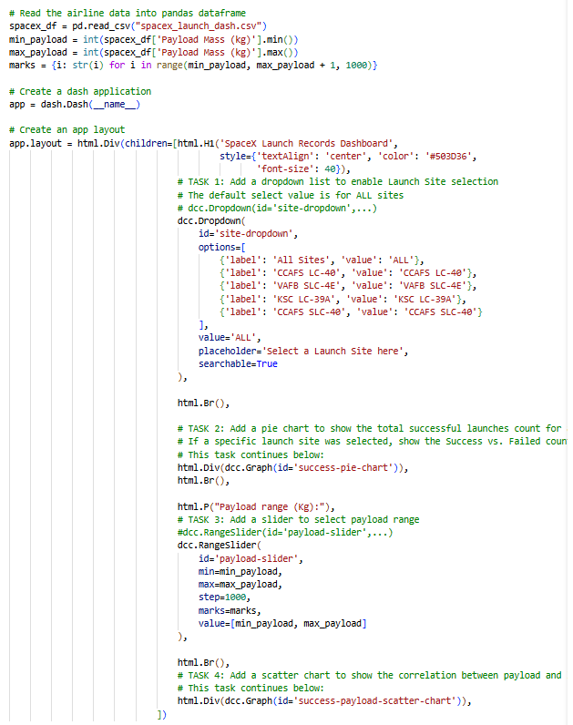
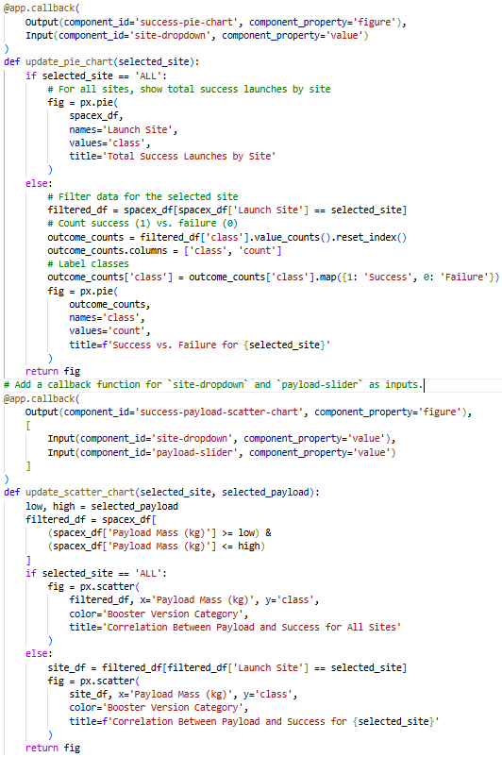
Appendix 3 – Interactive Dashboard with Plotly Dash
Code used to build the Interactive Dashboard with Plotly Dash

Slide 49


